Slide 1
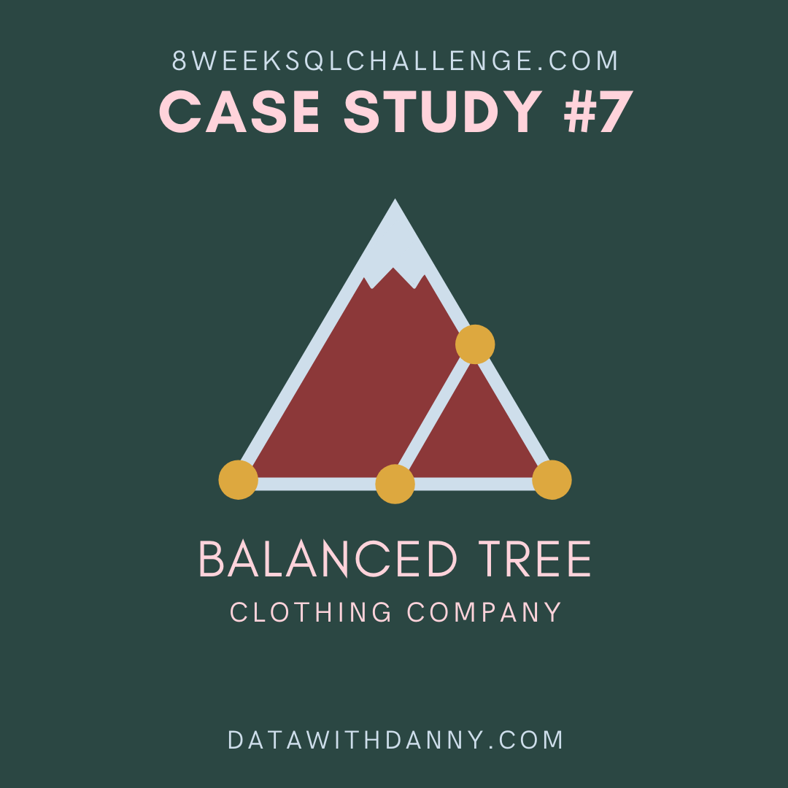
8 Week SQL Challenge
Case Study #7 - Balanced Tree Clothing Co.

Slide 2
Introduction
Balanced Tree Clothing Company prides themselves on providing an optimised range of clothing and lifestyle wear for the modern adventurer!
Danny, the CEO of this trendy fashion company has asked you to assist the team’s merchandising teams analyse their sales performance and generate a basic financial report to share with the wider business.

Slide 3
Case Study Questions
High Level Sales Analysis
What was the total quantity sold for all products?
What is the total generated revenue for all products before discounts?
What was the total discount amount for all products?
Transaction Analysis
How many unique transactions were there?
What is the average unique products purchased in each transaction?
What are the 25th, 50th and 75th percentile values for the revenue per transaction?
What is the average discount value per transaction?
What is the percentage split of all transactions for members vs non-members?
What is the average revenue for member transactions and non-member transactions?
Product Analysis
What are the top 3 products by total revenue before discount?
What is the total quantity, revenue and discount for each segment?
What is the top selling product for each segment?
What is the total quantity, revenue and discount for each category?
What is the top selling product for each category?
What is the percentage split of revenue by product for each segment?
What is the percentage split of revenue by segment for each category?
What is the percentage split of total revenue by category?
What is the total transaction “penetration” for each product? (hint: penetration = number of transactions where at least 1 quantity of a product was purchased divided by total number of transactions)
What is the most common combination of at least 1 quantity of any 3 products in a 1 single transaction?

Slide 4
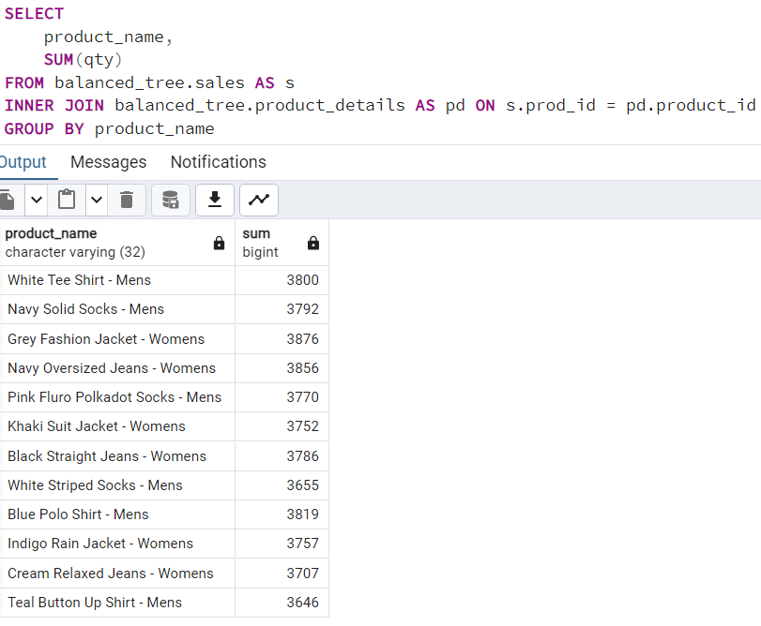
A. High Level Sales Analysis
1. What was the total quantity sold for all products?

Slide 5
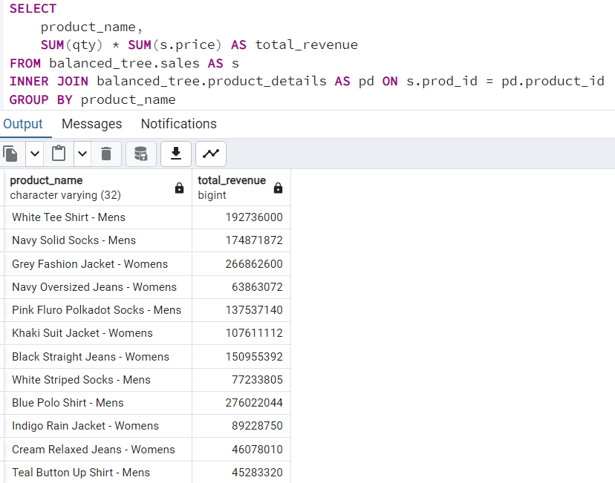
2. What is the total generated revenue for all products before discounts?

Slide 6
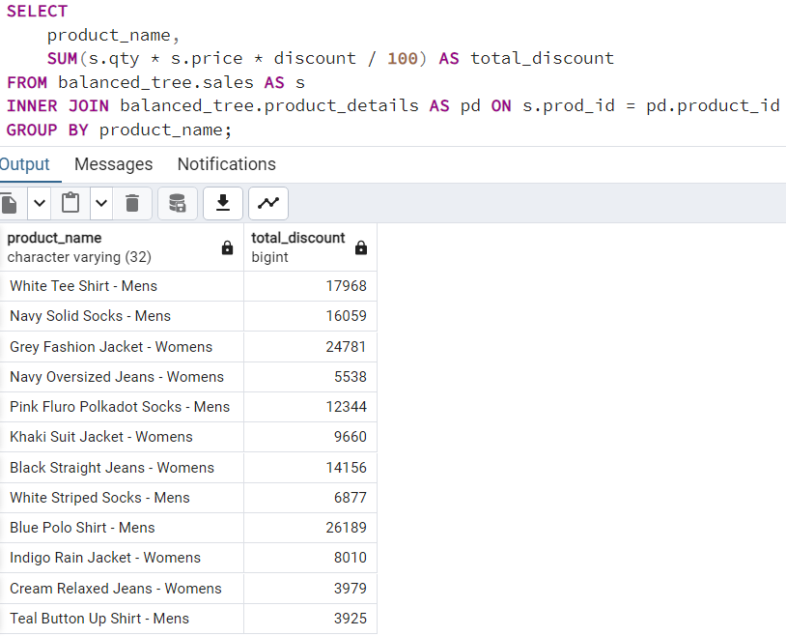
3. What was the total discount amount for all products?

Slide 7
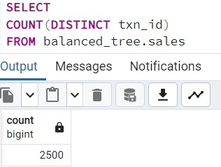
B. Transaction Analysis
1. How many unique transactions were there?

Slide 8
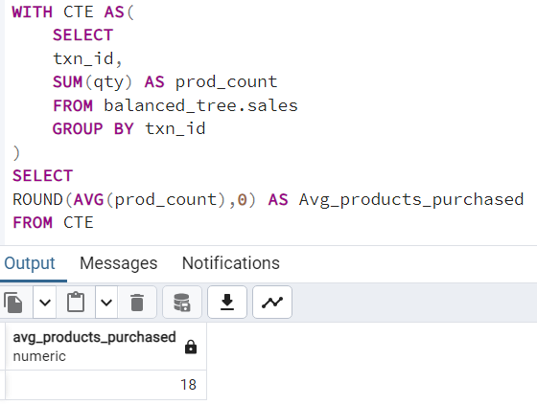
2. What is the average unique products purchased in each transaction?

Slide 9
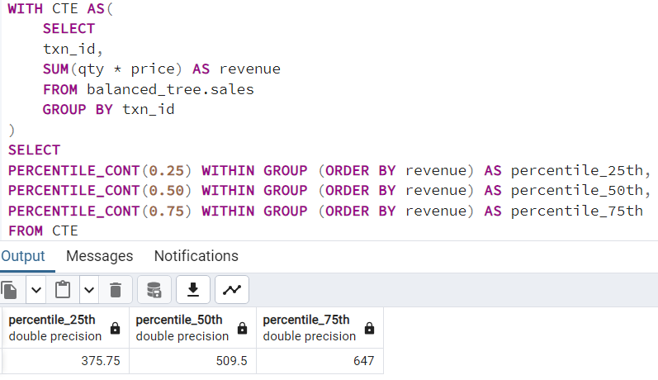
3. What are the 25th, 50th and 75th percentile values for the revenue per transaction?

Slide 10
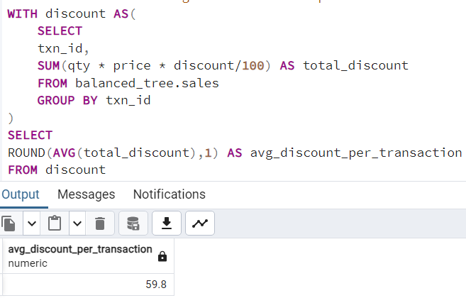
4. What is the average discount value per transaction?

Slide 11
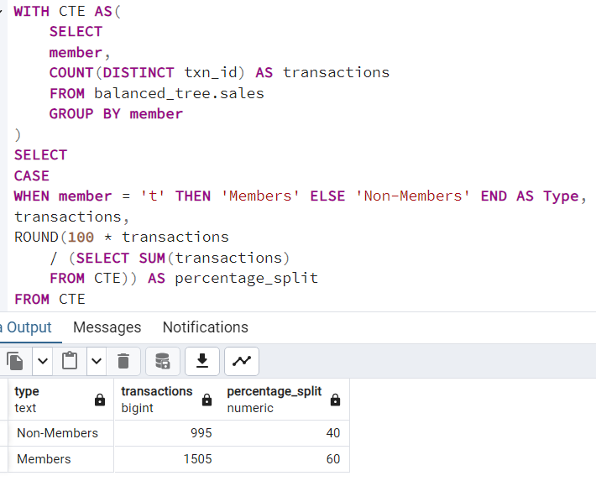
5. What is the percentage split of all transactions for members vs non-members?

Slide 12
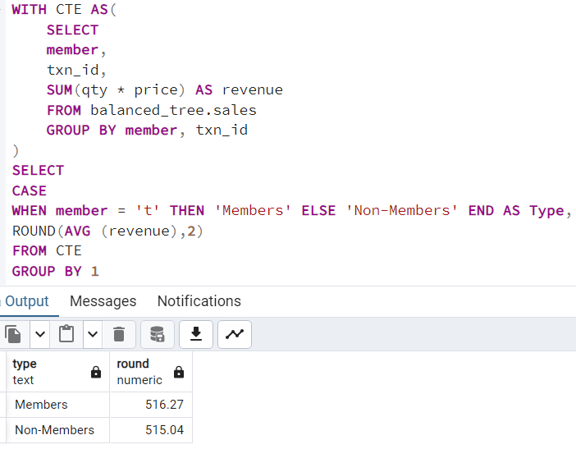
6. What is the average revenue for member transactions and non-member transactions?

Slide 13
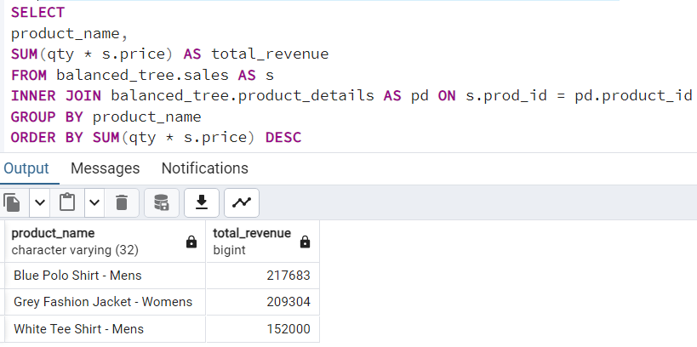
C. Product Analysis
1. What are the top 3 products by total revenue before discount?

Slide 14
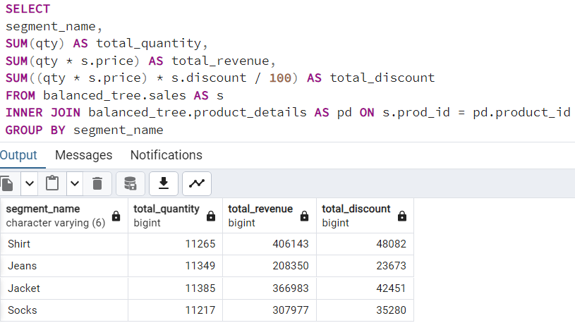
2. What is the total quantity, revenue and discount for each segment?

Slide 15
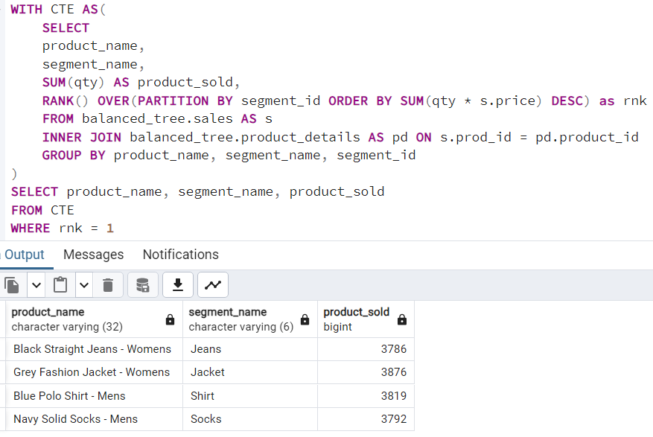
3. What is the top selling product for each segment?

Slide 16
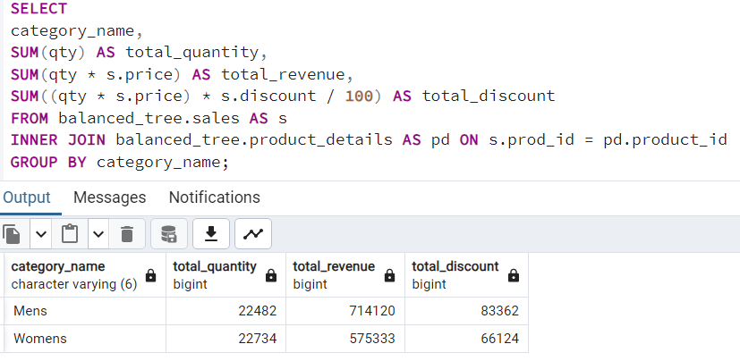
4. What is the total quantity, revenue and discount for each category?

Slide 17
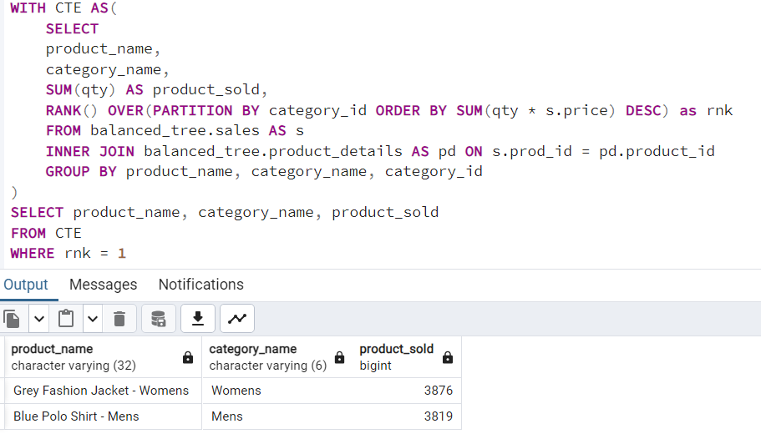
5. What is the top selling product for each category?

Slide 18
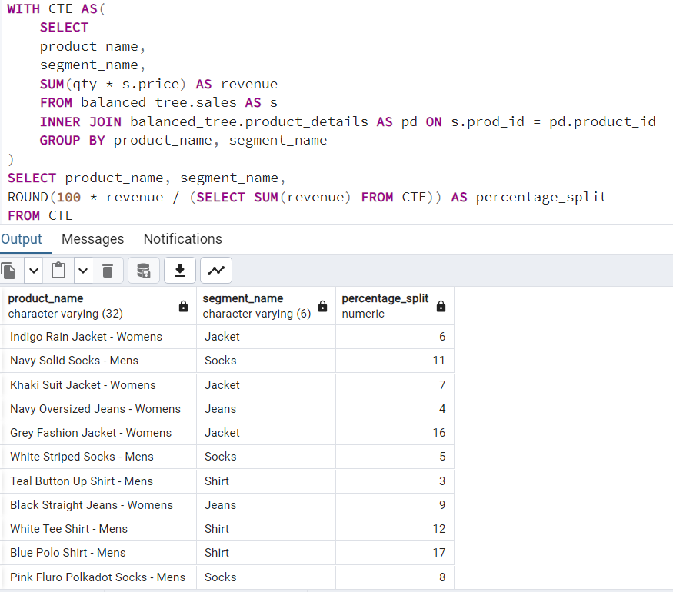
6. What is the percentage split of revenue by product for each segment?

Slide 19
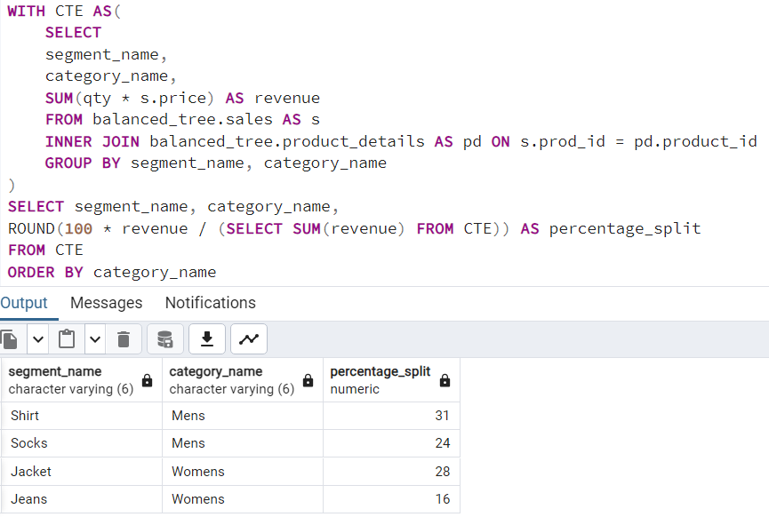
7. What is the percentage split of revenue by segment for each category?

Slide 20
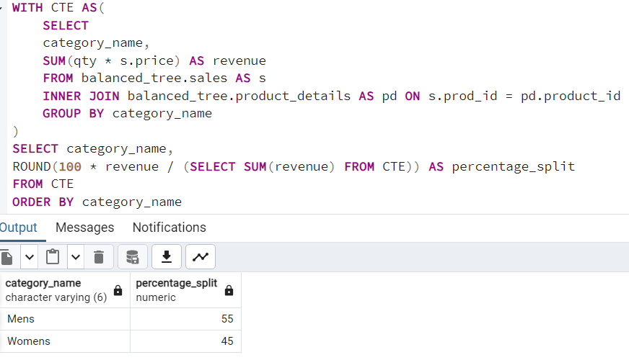
8. What is the percentage split of total revenue by category?

Slide 21
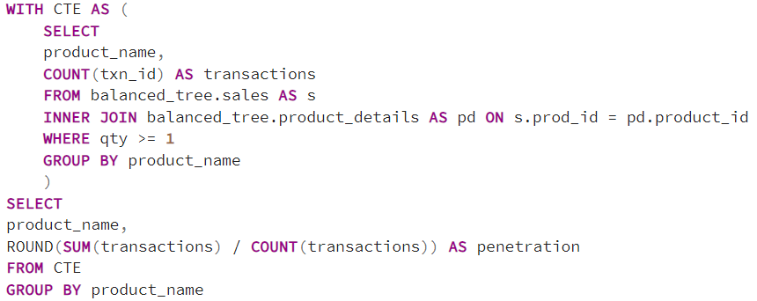
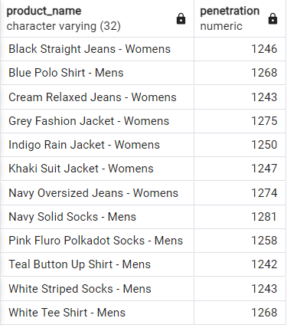
9. What is the total transaction “penetration” for each product?

Slide 22
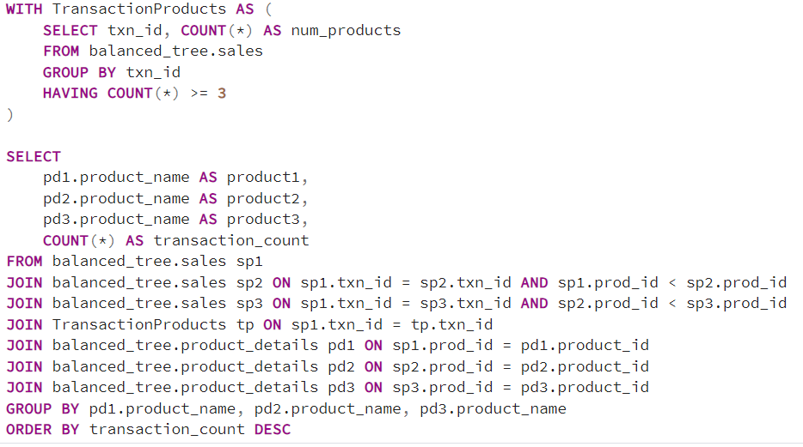

10. What is the most common combination of at least 1 quantity of any 3 products in a 1 single transaction?

